Slide 1
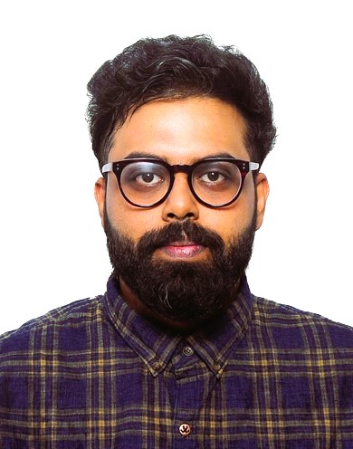

Tuhin Mitra
What can I do for you?
Tuhin is an automation architect with the Consulting QE team at KPMG Global Services (KGS), India. I have over 10 years of IT experience in the Cloud Automation, DevOps and AI solutions. Have worked on Projects on Agile and Scrum Methodologies. Have hands-on experience in designing and developing test strategies, test plans, test scenarios, creating automation test frameworks, test scripts and end-to-end solutions. Have delivered multiple testing projects in industry domains like Insurance, Banking, HealthCare, Automobile, HRMS.
Experience on Functional Testing, End to End, Regression Testing, Compatibility Testing, Integration testing. Involved in reviewing Business requirements, designing the task bots and executing them on the cloud. Experience on JIRA & Azure DevOps and sending DSR,WSR & Defect Reports to the Stakeholders. Co-ordinate with developers, testers and other individuals involved in the project to resolve the identified issues. Highly skilled and experienced in managing a diverse range of expertise, including Customer Relations, Resourcing, and Technology. Proficient in managing small to large-scale, multidimensional and complex programs for clients, ensuring that both client and KGS success and quality parameters are met. Adept in managing AI and Digital Transformation initiatives, as well as developing and implementing scalable AI architectures ranging from Windows-based applications to cloud-orchestrated solutions.
Project Management: Architecture plans, technology blueprints, risk management, quality control, budgeting, communication, escalation of issues.
Professional Experience: Manager, Consulting (QE Advisory) KPMG Global Services (KGS), India January 2023 – present. Spearheaded various AI and Digital Transformation initiatives for clients, including developing scalable AI architectures from Windows-based applications to cloud-orchestrated solutions. Managed QE programs for clients, ensuring that quality parameters and KGS success are met. Led the development and implementation of AI-based frameworks using GenAI to address various organizational quality engineering aspects. Managed automation initiatives, including developing and implementing Selenium and Tosca based solutions, forging partnerships with different member firms worldwide, and establishing relationships for powerful deliveries. Managed resources and personnel, including overseeing budgets, communication, escalation of issues, and quality control.
Recent Engagement:
Lead the testing effort at one of the top banks to modernize their core lending platform from a legacy system to a AFSV platform. Working closely with the bank’s core team, we identified the process/procedures and transformed the traditional delivery of product delivery into a much fast and lean CICD process. I worked closely with our bank and onshore stakeholders to increase the focus on micro-level testing of software. Increased automation at the micro-level and integration testing enabled issues identified much earlier and faster deployment. My team actively manages, improves, and monitors application issues.
I was the project manager for one of our state clients to help resolve all their testing need by implementing end to end automation framework to test the infrastructure in AWS cloud and integrations with different mmis modules with the core system. Led a team of 8 resources with major tasks include preparing and submitting testing deliverables, identify testing resource needs .create test scenarios and test cases, manage the tasks and activities of the UAT Testers, prepare test execution status reports , log bugs in JIRA with detailed information needed for troubleshooting and attach the bug to the failed UAT test case
Played automation architect role in the Quality Engineering group. He played critical role in building automation framework to meet all aspects of the organization quality engineering vison and roadmap. Engagement included implementation of the automation framework to the organization and its related subsidiaries covering DevOps, mobile, web, ADA, Azure CI/CD and process improvement.
QE Manager
Employer: KPMG Global Services Private Limited
Address: Global Technology Park Tower D,E, Adarsh Palm Retreat, Bellandur, Bengaluru, Karnataka-560103 Dates of Employment: 08/25/2014 – Current
Contact Details :
Cell : +91- 9945562091
Email: tuhinmitra@kpmg.com
LinkedIn Profile: https://www.linkedin.com/in/tuhin-mitra-631970152/
Function &Specialization :
QE and AI Solution Manager with specialization in Health Care Domain and Banking. Functional and Automation testing experience in Health Care, Banking, Insurance domain.
Representative Clients:
State Of Hawaii, DCAS, NC MMIS, Regions Bank
Education and Certification: 05/27/2013
Bachelor of Technology in Information Technology
Technical Skills:
Proficient: Selenium Automation, Katalon, Cucumber, Postman, VBA, Junit, API, TOSCA, Parasoft
Languages: Java, Python, SQL
Build Tools: Jenkins, Azure Devops
Database: MySQL, Oracle 12c, 11g
Intermediate: Machine Learning, Data Science, Tableau, Power BI, Devops
Azure , OCI, AWS, Docker, Terraform, Kubernetes
Tools Created:
TCG, Document Search BOT, RAAT, CAAT, THOR

